Slide 1
Module 2 – Housing Price
Andy Peng
Notes:
Hi my name is Andy Peng. Welcome to my presentation for Flatiron School Module 2 – Housing Price. For the extent of this project, our stakeholders are a company that focuses on finding affordable family houses in the King County Area.

Slide 2
Overview
Relationship to housing prices
Waterfront View
Zip Codes
Square Footage Living
Notes:
We managed to create a model that can predict housing prices within an $80,000 error interval. However, for the extent of this presentation we will be focusing on the following features waterfront view, zip codes and square footage of the house.

Slide 3
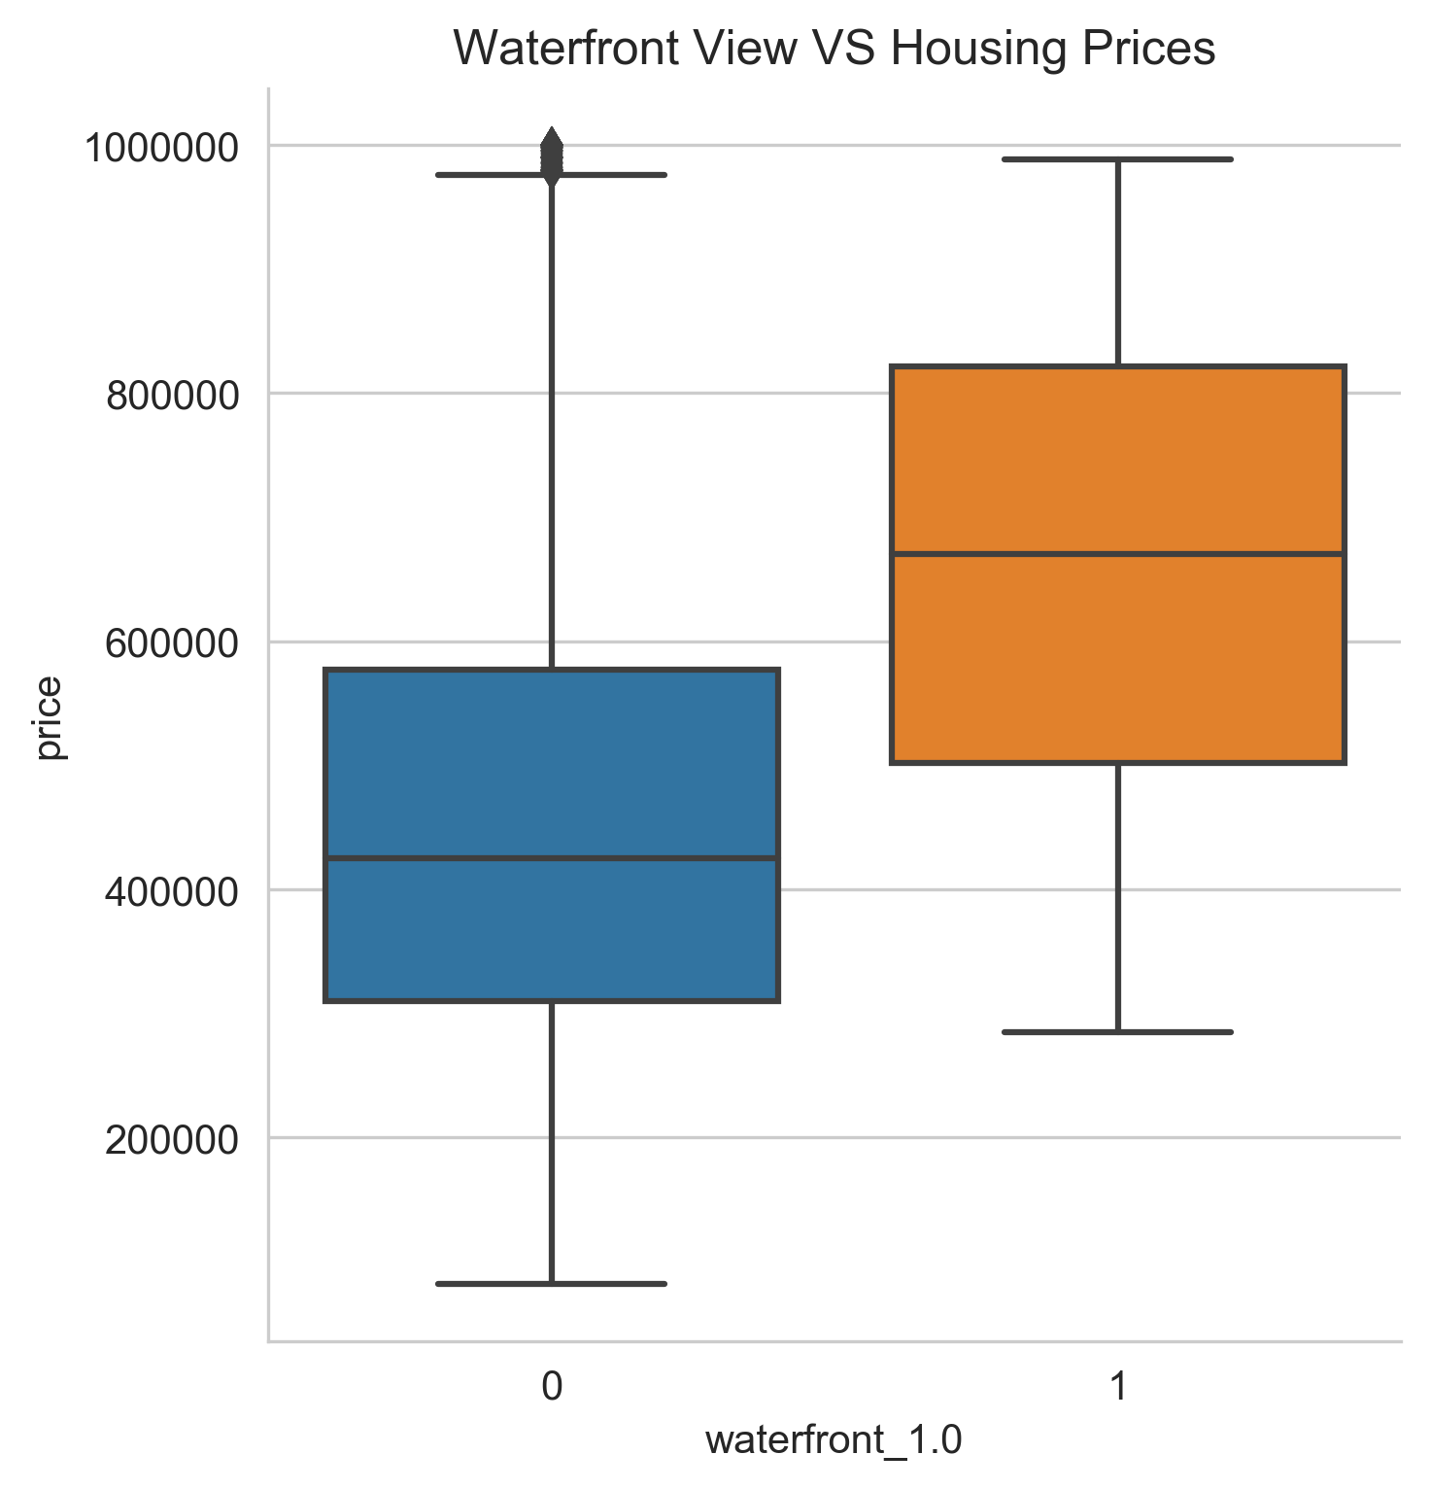
Does waterfront view affect housing prices?
Notes:
Does having a waterfront view affect housing prices? Let’s look at this graph here, on the left-hand side we have a box plot of housing prices without a waterfront view and on the right-hand side we have a box plot of housing prices with a waterfront view. Although the maximum housing prices of not having a waterfront view and having a waterfront view are relatively similar, we can see that without a waterfront view we have a smaller median and minimum value for housing prices. According to our model we can see that houses with waterfront view on average tend to cost about $275,000 more than houses without waterfront view.

Slide 4
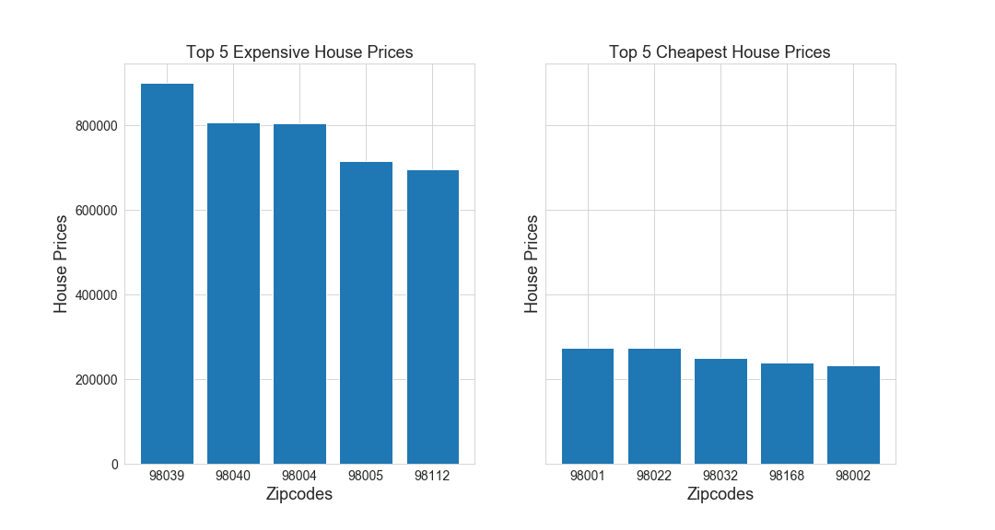
Do zip codes effect housing prices?
Notes:
Does zip codes effect housing prices? I have calculated the average housing prices of each zip code. The graph on the left represents the top 5 zip codes with the most expensive housing prices and the graph on the right represents the top 5 zip codes with the cheapest housing prices. As we can see there is a significant difference between the prices. Now let’s look at the zip codes on a map.

Slide 5
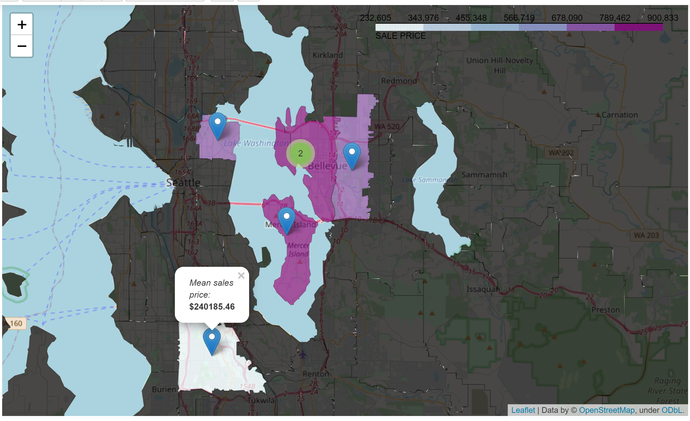
Mapping of the previous graph
Notes:
We took the data from the previous graph to see if we can understand the difference in the housing prices. As we can see above, we see that the most expensive housing prices are all clutter in one location. Let’s take a look at all the King County Data zip code values.

Slide 6
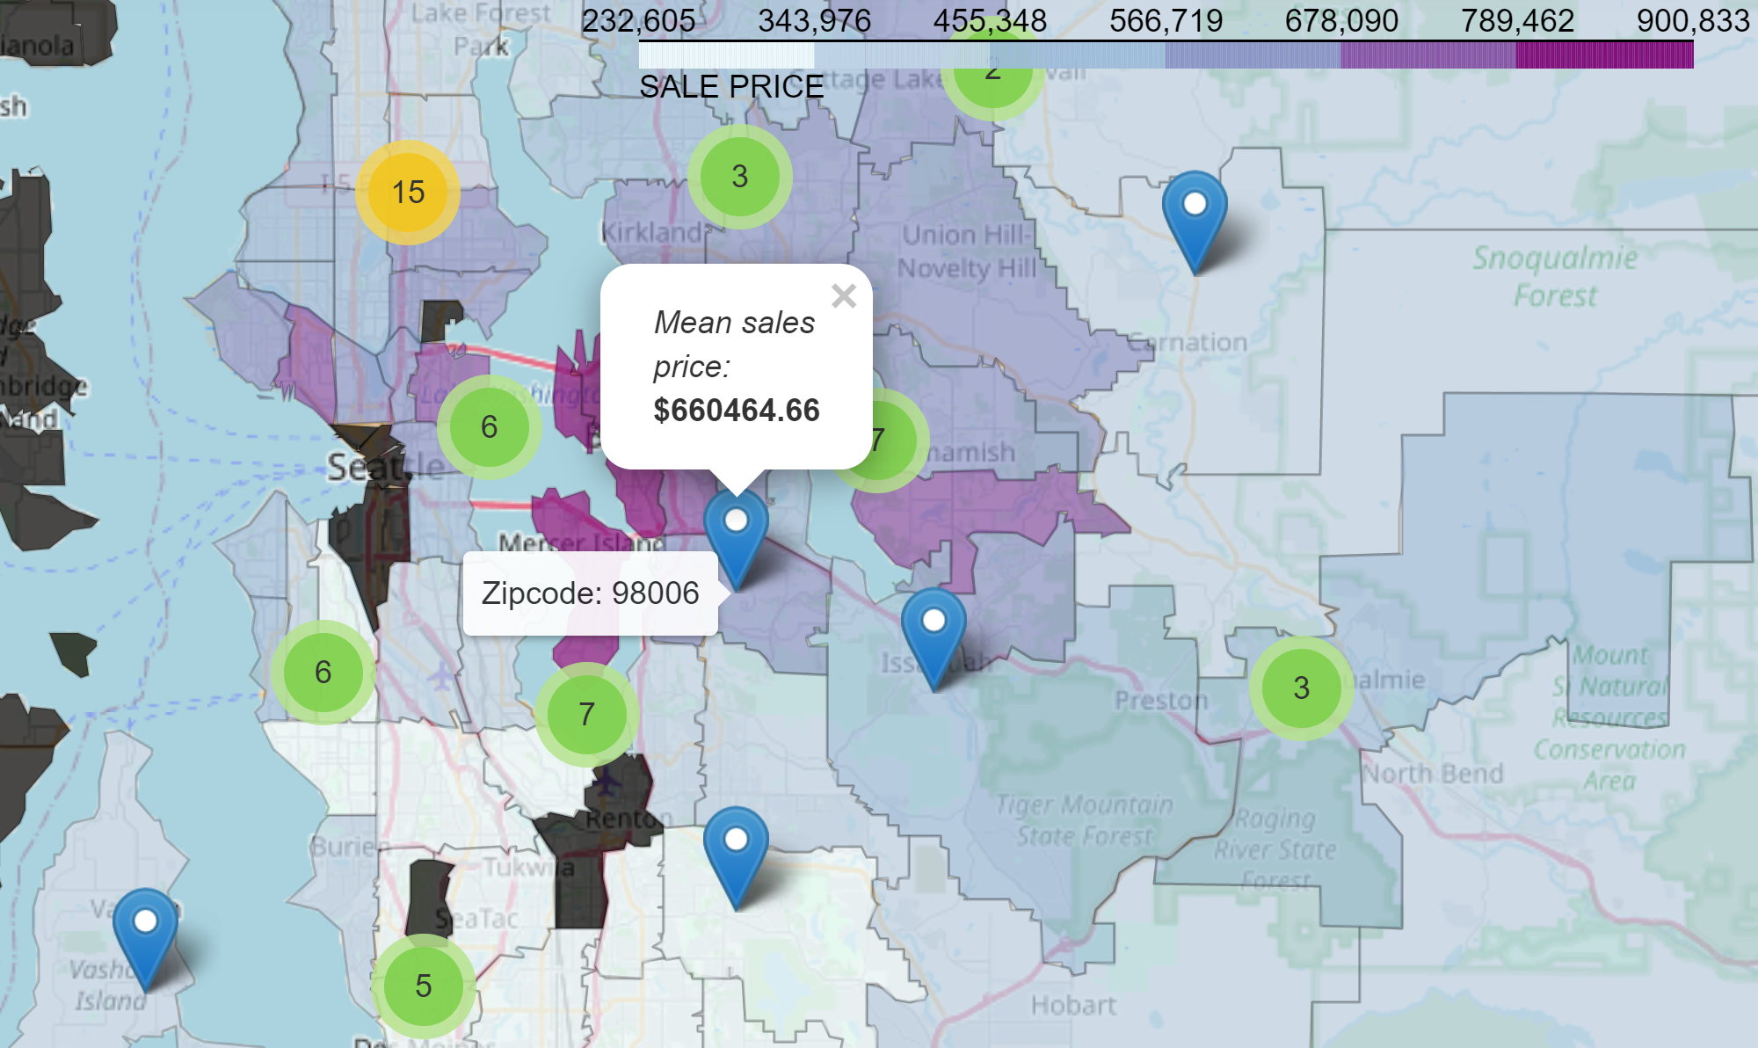
Mapping of all zip code housing prices
Notes:
Now that we included all the zip code values from the King County Data, we can get a bigger picture. Our map here displays the zip code and the average housing prices of all zip code related to that area.

Slide 7
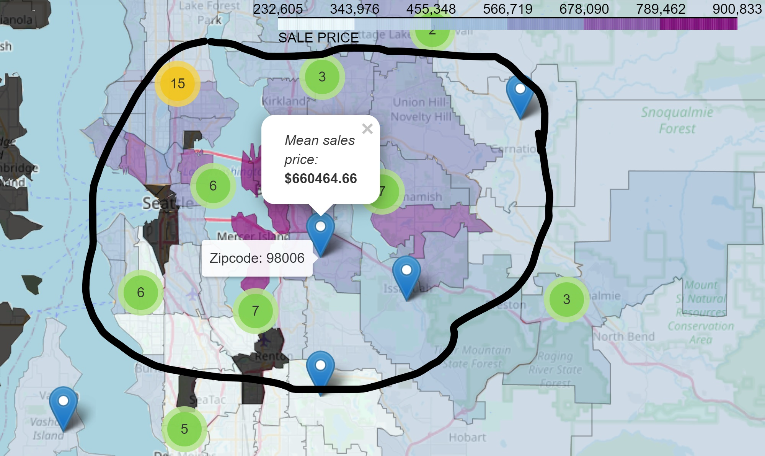
Mapping of all zip code housing prices
Notes:
This is where majority of the expensive housing prices are. Most of them are located near Mercer Island. As you move farther away from Mercer Island, the prices tend to be lower.

Slide 8
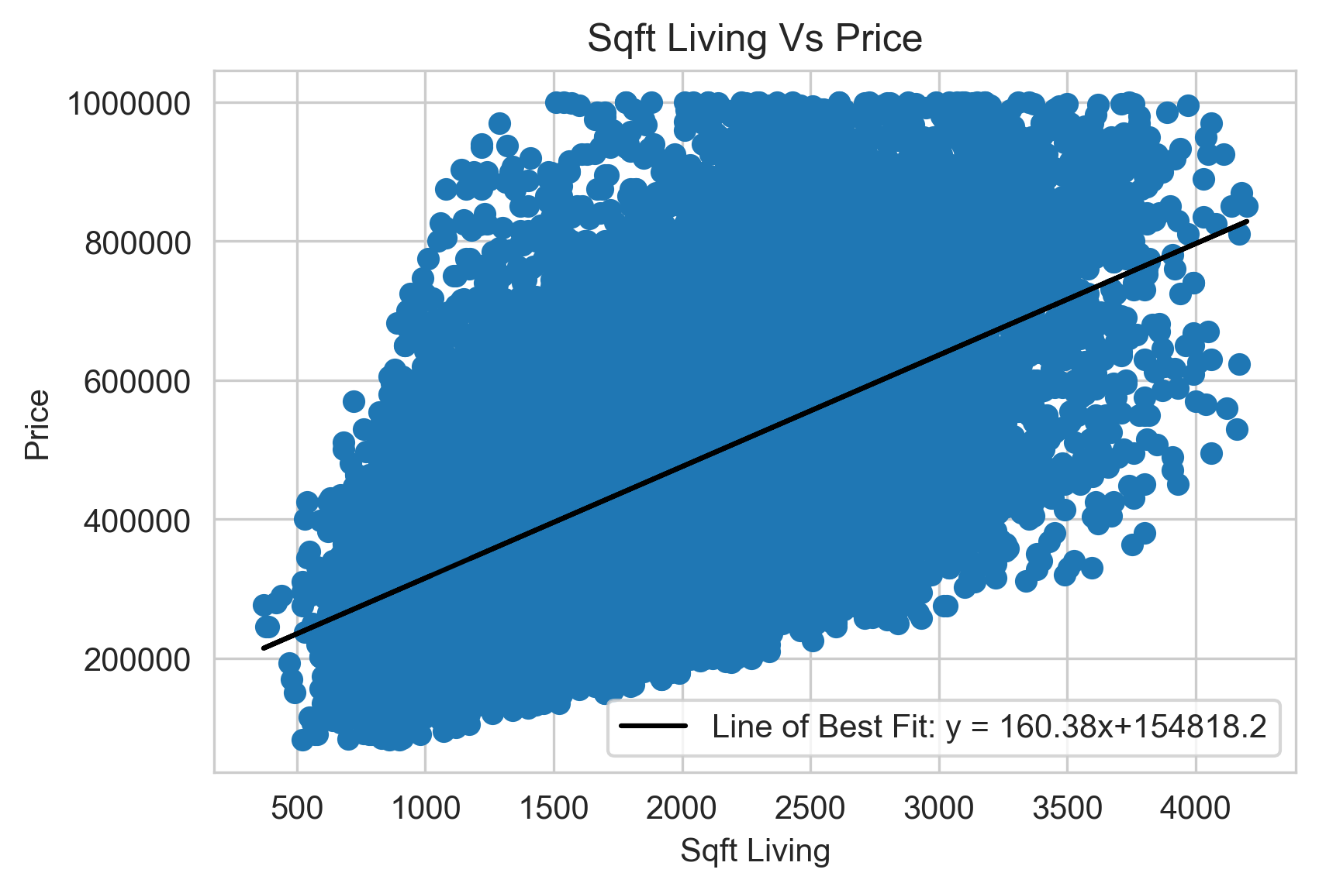
Do square footage of house effect housing price?
Notes:
Do square footage of houses effect housing prices? As we can see above that there is a positive correlation between square footage of the house and housing prices. In other words as the square footage of the house increase, the housing prices would also increase too. According to our model for each square footage increase we can see about an increase of $25. This may not seem a lot but square footage space adds up.

Slide 9
Recommendations
Looking at houses without a waterfront view
Buying houses around certain zip codes
98001
98002
98022
Lower square footage = lower housing price
Notes:
Our goal is to buy affordable family houses and so these are the things that we should follow in order to buy cheaper houses. We should focus on houses without waterfront view because the housing prices with waterfront view on average costs more. Next, we need to consider location of houses. For example we can buy houses around zip codes 98001, 98002, 98022, etc or like we mention earlier houses away from Mercer Island. We also recommend buying a smaller square footage for the house because the housing prices tend to be lower.

Slide 10
Next Steps
Features to Explore
Crime Rate
Schools in the area
Pictures of the house
Time of house sales
Gather More Data
Notes:
For our next step we can explore other key features such as the crime rates, schools in the area, pictures of the house and time of house sales. If we want to improve our model, gathering more data would help us do a better job at finding lower housing prices.

Slide 11
Thank You
Notes:
Thank You

